Slide 1
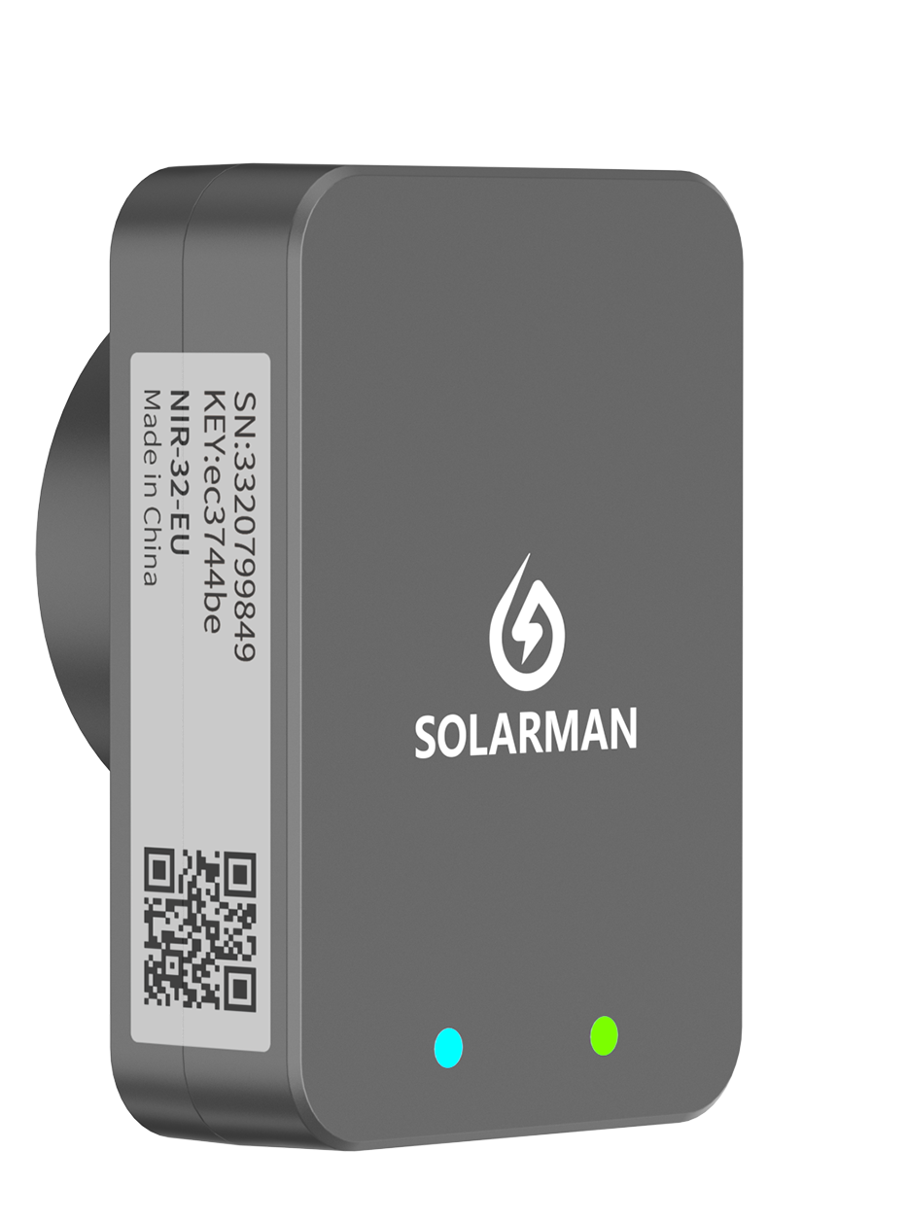
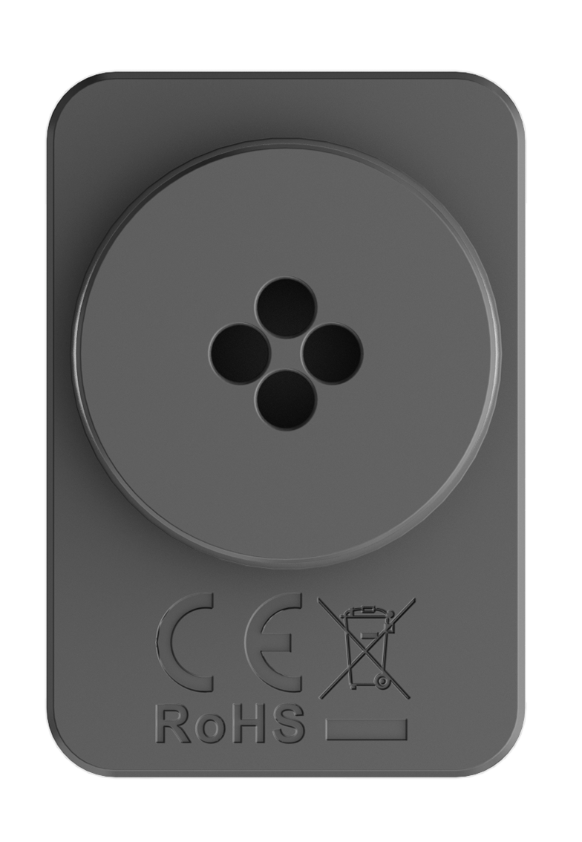
NIR-32-EU
Infrared Meter Reader
The infrared meter reader mainly monitors the electricity meter system in a long-term and effective manner by collecting the working status and electricity consumption of the infrared electricity meter. It connects to a single infrared electricity meter via an "infrared interface", receives various consumption data from the meter, and transmits the data to local or remote software platforms through WiFi. The real-time status and historical data of the electricity meter can be presented in the form of charts, which are intuitive and easy to understand. This allows users to monitor the electricity meter system anytime and anywhere, greatly simplifying maintenance work.
Applicable Scenarios
Suitable for household users with infrared electricity meters in Europe 1.No manual meter reading required, avoiding problems of inaccurate data and complex operations; 2.Local API interface calling, obtaining consumption data quickly and access Home Energy Management System efficiently ; 3.Real time electricity meter data monitoring, realizing smart energy management; 4.Accurate consumption data analysis, achieving revenue increasement and electricity cost control.
Features
Compact size, easy to install
Four-hole design to adapt to different electricity meter structures
Standard Bluetooth for fast network configuration with high success rate
Configurable LoRa technology for easy remote relay communication
Optional RS485 interface for local data reading
Seamless communication with various smart electricity meter models
Compliant with EN 18031 IoT network security standard

Slide 2
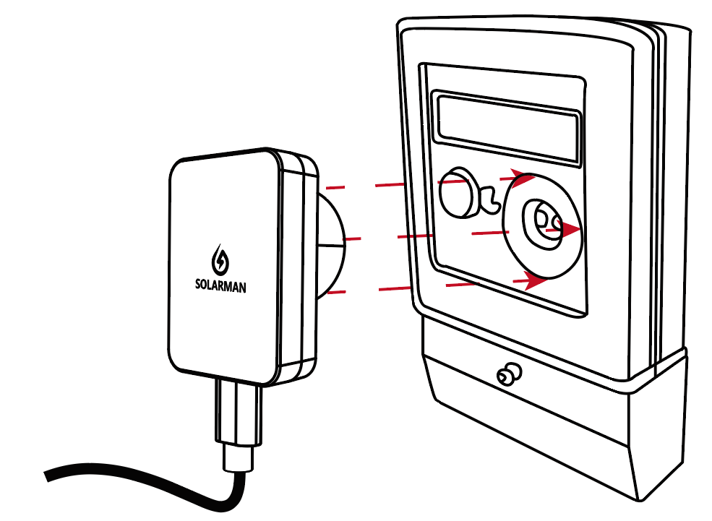
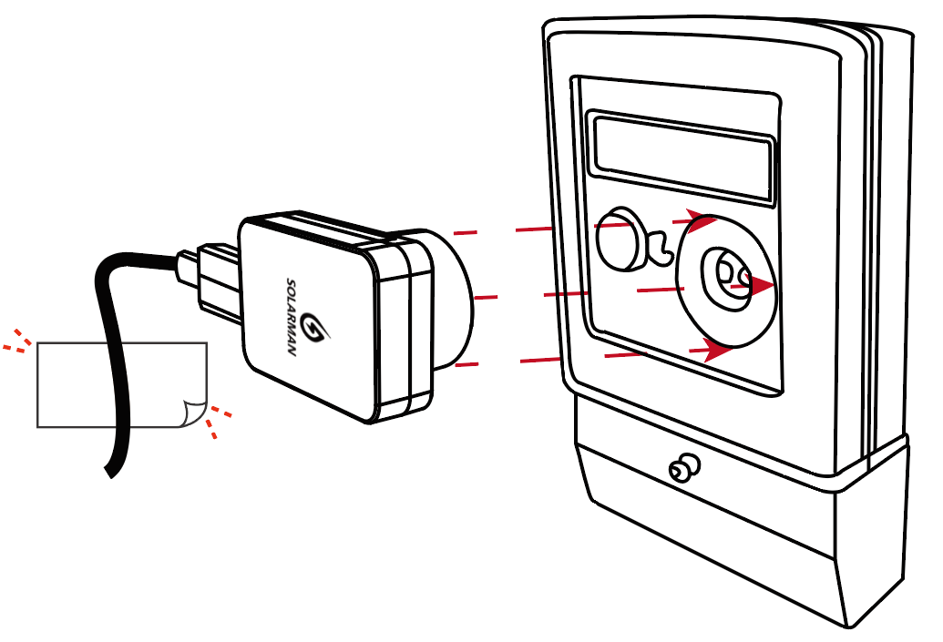

Parameter
Communication Parameter
Installation①
Remote Communication | WiFi
WiFi Standard | 802.11 b/g/n
WiFi Frequency Range | 2.412GHz-2.484GHz
WiFi Transmission Power | 802.11b: +20.5dBm (@1Mbps) 802.11b: +20.5dBm (@11Mbps) 802.11g: +20.0dBm (@6Mbps) 802.11g: +18.0dBm (@54Mbps) 802.11n: +19.0dBm (@HT20, MCS0) 802.11n: +17.5dBm (@HT20, MCS7) 802.11n: +18.5dBm (@HT40, MCS0) 802.11n: +17.0dBm (@HT40, MCS7)
Bluetooth Standard | BLE 5.0
Bluetooth Operating Frequency | 2.402GHz-2.480GHz
Bluetooth Transmission Power | Max 20dBm
LoRa Operating Frequency Band（Configurable） | 864MHz~928MHz
LoRa Transmission Power（Configurable） | Max 22dBm
Antenna | Bluetooth/WiFi on-board antenna, LoRa on-board antenna（Configurable）
Installation②
Hardware Parameter
Installation Method | Magnetic suction type: vertical installation, horizontal installation
Product Size | 34mm50mm28.3mm (excluding power cable)
Power Interface | USB-C
Data Interface | Infrared transceiver @ wavelength 940nm
Communication Distance | ≤10mm±1mm
Data Storage | 8MB
Operating Voltage | DC 5.0V±5%
Operating Power | ＜3W
Indicator Lights | One for electricity meter connection status - infrared green light One for server connection status - WiFi blue light
Button | One reset button
Operating Temperature | -20℃~+50℃
Operating Humidity | 10%-70% relative humidity, no condensation
Storage Temperature | -25℃~+60℃
Storage Humidity | <40%
Software Parameter
Number of Connected Infrared Electricity Meters | 1 unit
Data Collection Interval | SML protocol: 2s OBSI protocol: 30s~2min
User Configuration | Local configuration, remote configuration
Firmware Upgrade | Local upgrade, remote upgrade
Restart Mechanism | Software watchdog, hardware watchdog
Others | Real-time control, breakpoint resume
www.solarman.com | info@solarmanpv.com | +86 400-181-0512

